Slide 1
SQL In Depth

Slide 2
Lecture Outline
DESCRIBE Function
Concatenation Function
Applying DISTINCT to data
WHERE Clause
Operators

Slide 3
Describe
The DESCRIBE (DESC) command is often leveraged to view the structure of database objects.
It returns the following:
Table name
Data Types
Primary and Foreign Keys
Nullable Columns
And much more !!

Slide 4
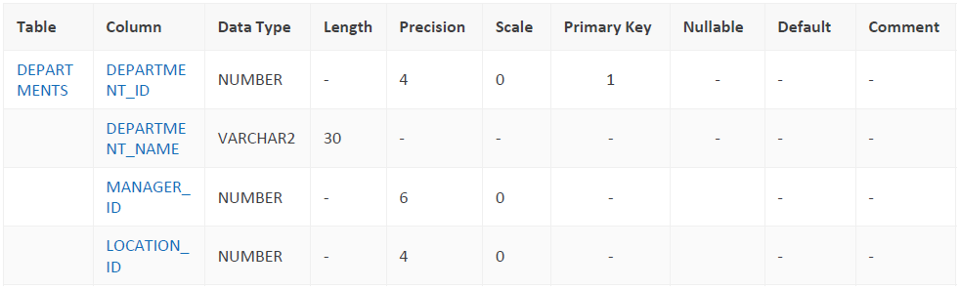
Describe - Command
DESC departments

Slide 5
When to use DESC?
Understanding the structure of the table prior to inserting data is critical.
You want to ensure that you comply with the following:
Column data type
Precision – For example, VARCHAR(30) has a precision of 30 characters, if I put 100 characters, it will truncate.
NOT NULL – understanding if the column is expecting data
Primary/Foreign Key constraints – unique values for relationships between tables
Etc…
Therefore, DESC will help you as a DBA understand what information is required to satisfy the DML request.

Slide 6
Concatenation Operator
You will be often faced with situations where you want to produce a character String.
“CPAN 121 is an amazing course at Humber College!”
CPAN121 and Humber College could be two distinct columns values from your table that you want to concatenate to produce a single statement.
Syntax:
string1 || string 2 || string3 || … stringn

Slide 7
Example Concatenation Operator
How would you concatenate together department_id and department_name from table departments?
Department_id | department_name | …
10 | Administration | …
20 | Marketing | …
50 | Shipping | …
60 | IT | …
… | … | …

Slide 8
Example Concatenation Operator
How would you concatenate together department_id and department_name ?
SELECT department_id || department_name FROM departments;
DEPARTMENT_ID || DEPARTMENT_NAME
10Administration
20Marketing
50Shipping
60IT
…
Great, but can we make this better? More readable, how?

Slide 9
Continuing Concatenation Operator
How would you concatenate together department_id and department_name ?
SELECT department_id || ‘ ‘ ||department_name as “Department Info” FROM departments;
Department Info
10 Administration
20 Marketing
50 Shipping
60 IT
…
Alias that can change the column heading
The ‘space’ character in single quotation marks creates a space between the column values. But this could be any character value too.

Slide 10
Question for you…
What issues do you see with this table ?
DEPARTMENT_ID
90
90
90
10
110
110
20
80
80
80

Slide 11
DISTINCT
There will be many instances where you want to know how many unique instances of something exists.
In this case, how many distinct department ids exist?
The DISTINCT clause is used in a SELECT statement to filter duplicate rows in a result set.
Ensures that rows returned are unique for each column or columns specified in the SELECT clause.

Slide 12
Distinct Question….Going back
How would you change this query to show distinct department_ids ?
SELECT department_id FROM departments;
DEPARTMENT_ID
90
90
90
10
110
110
20
80
80
80
DEPARTMENT_ID
90
10
110
20
80

Slide 13
Distinct Question….Going back
DISTINCT is a SELECT clause, it must appear directly after the SELECT keyword
SELECT DISTINCT department_id FROM departments;
DEPARTMENT_ID
90
90
90
10
110
110
20
80
80
80
DEPARTMENT_ID
90
10
110
20
80

Slide 14
SELECT Statement
The SELECT statement is a foundational concept– its purpose is to retrieve information from the database.
The SELECT must include at the minimum a SELECT clause and a FROM clause
The WHERE clause is an optional – we will talk about this shortly!
Specific columns that you want to retrieve data for.
* Indicates select all columns
Optional distinct clause
SELECT*|{[DISTINCT] column | expression alias]..}
FROM table
[WHERE condition(s)];
Specifies table(s) that you want to select data against.
Specifies a search condition for rows returned by the SELECT statement

Slide 15
SELECT Statement Examples
Employee
ID | F_NAME | L_NAME | Age | SIN | Salary | Bonus
1 | Paul | Singh | 34 | 123 323 232 | $2,100,000 | $150,000
2 | Doug | Jones | 15 | 654 454 541 | $15,000 | $500
3 | Mary | Smith | 15 | 844 457 512 | $89,000 | $5000
4 | … | … | … | … | … | …
First option is far easier to type for selecting ALL data.
Retrieve all data from employee table
SELECT * FROM employee;
SELECT ID, F_NAME, L_NAME, AGE, SIN, SALARY, BONUS FROM employee;
Retrieve F_NAME from employee table where bonus greater than 1000
Specify ONLY F_NAME, we don’t need everything (*) – slow performance!
SELECT F_NAME FROM employee where bonus > 1000;
Retrieve DISTINCT age from employee table
SELECT DISTINCT age FROM employee;

Slide 16
WHERE Clause
When retrieving data from the database, you may need to limit the rows of data that are displayed.
You can accomplish this using the WHERE clause.
A WHERE clause contains a condition that must be met, and it directly follows the FROM clause in a SQL statement.
The syntax for the WHERE clause is:
Note: An alias cannot be used in the WHERE clause!
WHERE column_name comparison_condition comparison_value

Slide 17
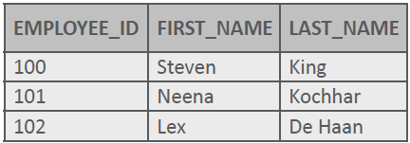

WHERE Clause
Examine the following SQL statement from the Employees database:
By adding a WHERE clause, the rows are limited to those rows where the value of employee_id is 101.
SELECT employee_id, first_name, last_name
FROM employees;
SELECT employee_id, first_name, last_name
FROM employees
WHERE employee_id= 101;

Slide 18
Comparison Operators in WHERE Clause
Recall the this example – the idea was retrieve f_name from employee table where the bonus (another column) was greater than 1000.
Comparison operator!!
SELECT F_NAME FROM employee where bonus > 1000;
All the comparison operators that all database have available:
Operator | Description
= | Equal to
> | Greater than
>= | Greater than or equal to
< | Less than
<= | Less than or equal to
<> | Not equal to

Slide 19
Comparison Operators Examples
Employee
ID | F_NAME | L_NAME | Age | SIN | Salary | Bonus
1 | Paul | Singh | 34 | 123 323 232 | $2,100,000 | $150,000
2 | Doug | Jones | 15 | 654 454 541 | $15,000 | $500
3 | Mary | Smith | 15 | 844 457 512 | $89,000 | $5000
4 | … | … | … | … | … | …
Retrieve all employees with age of exactly 15
SELECT * FROM employee where age = 15
Retrieve F_NAME from employee table where bonus NOT equal to 500
Numeric values don’t need to be enclosed with ‘500’
SELECT F_NAME FROM employee where bonus <> 500;
Retrieve salary from employee table where last name is Smith
String value that we need to enclose with single quotes!!!
SELECT salary FROM employee where l_name = ‘Smith’;

Slide 20
Case Sensitive in WHERE clause
All character searches are case-sensitive
SELECT salary FROM employee where l_name = ‘Smith’;
SELECT salary FROM employee where l_name = ‘smith’;
These will produce different results – this is an important!
There are functions that can assist in ensuring that you don’t have to worry about these situations: UPPER, LOWER and INITCAP will help!
SELECT salary FROM employee where UPPER(l_name) = ‘SMITH’;
SELECT salary FROM employee where LOWER(l_name) = ‘smith’;

